Slide 1

British airways virtual internship- Costumer review analysis
23/11/2023

Slide 2
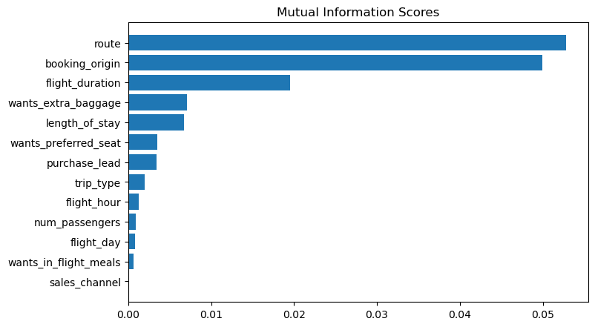
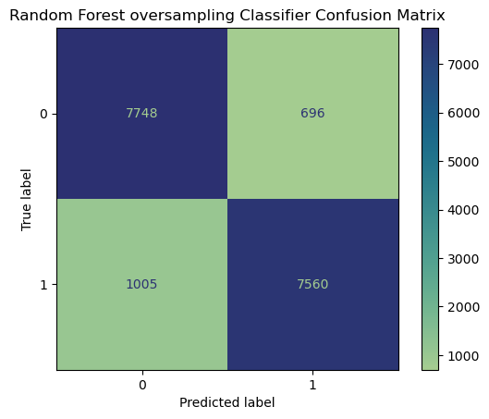
Predictive model results to understand factors influencing costumer booking behavior
Top features influencing booking are:
1. Route
2. Country origin
3. Flight duration
4. Extra baggage
5. Length of stay
Best algorithm to predict customer behavior is
Random Forest Classifier with oversampling.
Accuracy: 90%
ACU score: 0.9
F1 score: 0.9

